Slide 1

Biblical Sites Compared
Selected cities and regions compared
using MAPfrappe
All map imagery copyrighted by their respective copyright owners. Thanks to A.D. and Katerine Riddle for the creation of the images in this presentation.
Notes:
Last updated: June 23, 2014

Slide 2
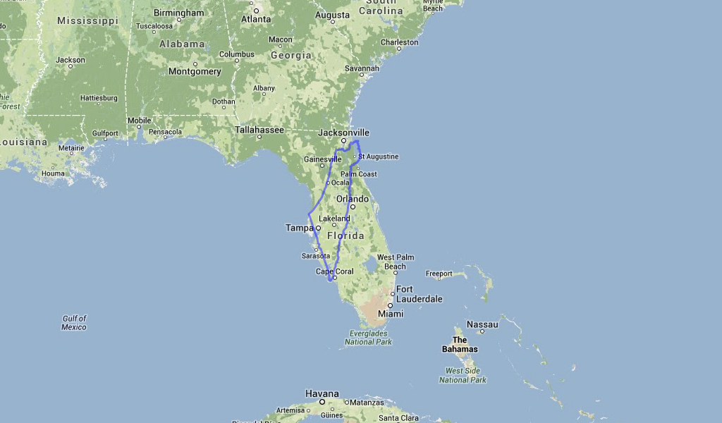
Israel vs. Florida
Notes:
Israel http://mapfrappe.com/?show=18894

Slide 3
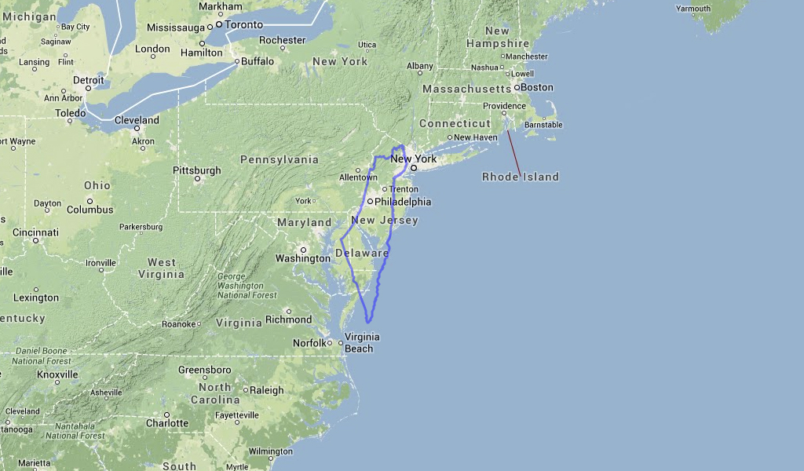
Israel vs. New Jersey and Delaware
Notes:
Israel http://mapfrappe.com/?show=18894

Slide 4
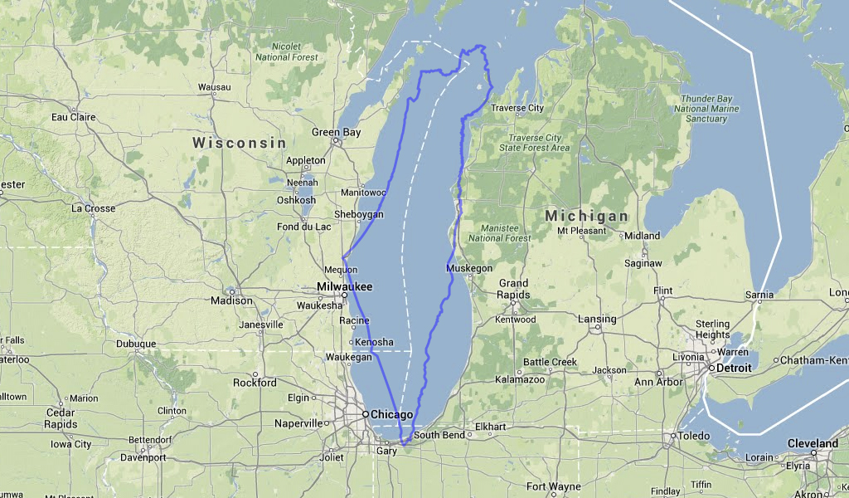
Israel vs. Lake Michigan
Notes:
Israel http://mapfrappe.com/?show=18894

Slide 5
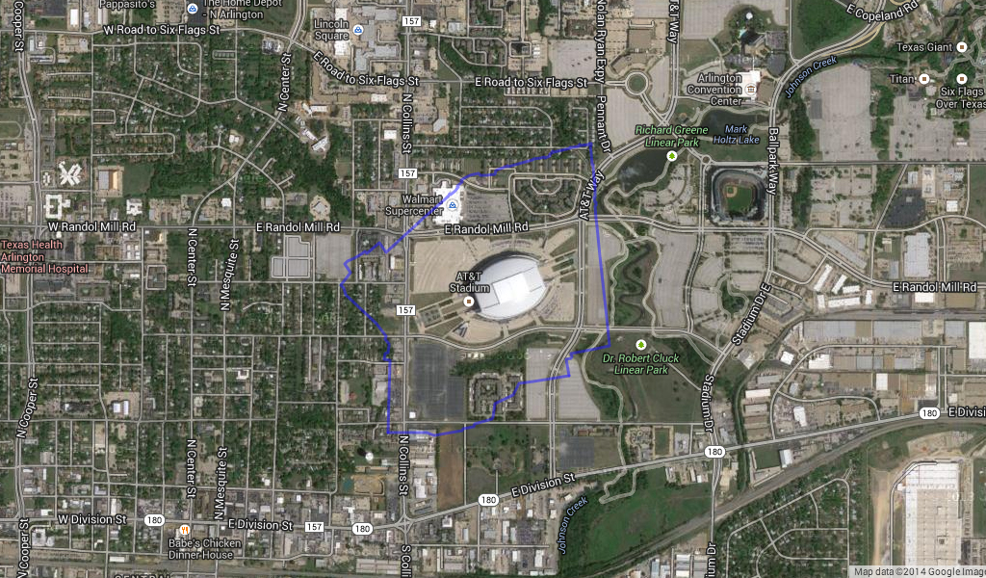
Jerusalem Old City vs. Dallas Cowboys Stadium
Notes:
Old City Jerusalem http://mapfrappe.com/?show=19152

Slide 6
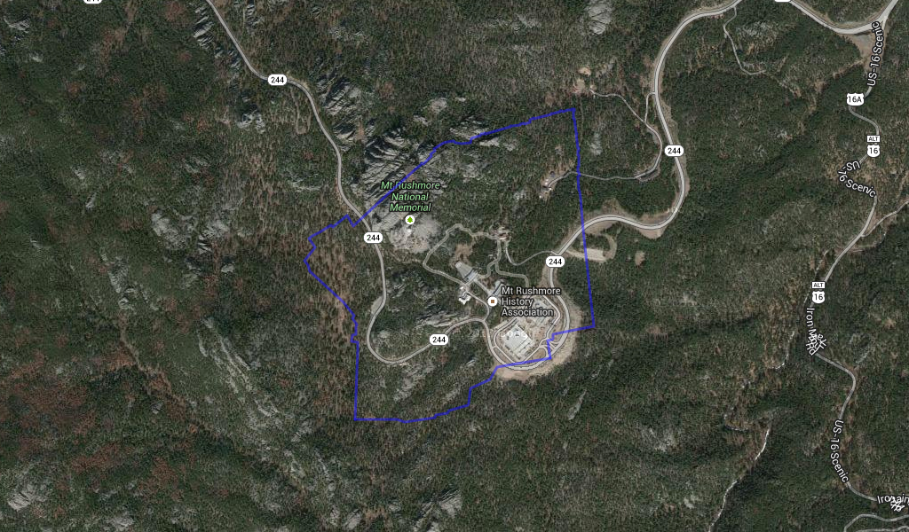
Jerusalem Old City vs. Mount Rushmore
Notes:
Old City Jerusalem http://mapfrappe.com/?show=19152

Slide 7
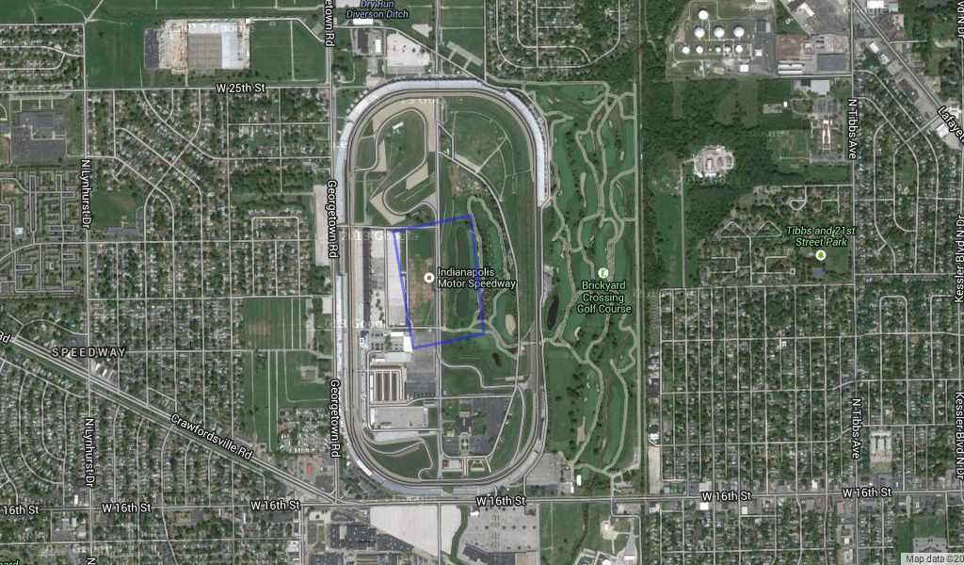
Temple Mount vs. Indy 500 Speedway
Notes:
Temple Mount http://mapfrappe.com/?show=18816

Slide 8
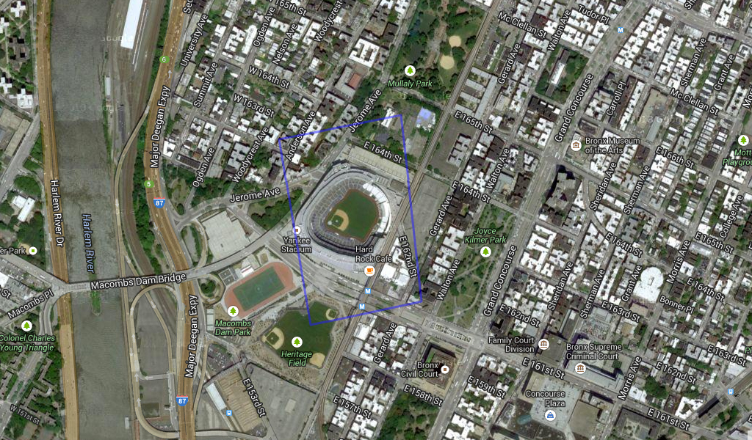
Temple Mount vs. Yankee Stadium
(two places of worship compared)
Notes:
Temple Mount http://mapfrappe.com/?show=18816

Slide 9
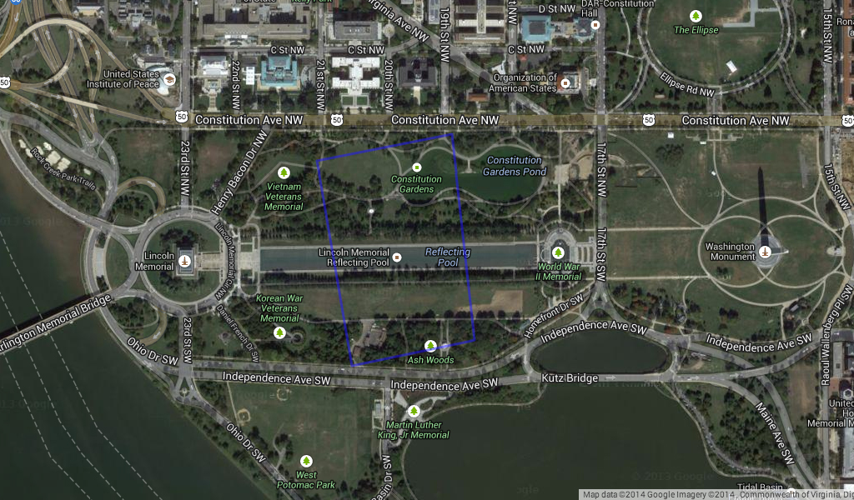
Temple Mount vs. Washington, DC
Notes:
Temple Mount http://mapfrappe.com/?show=18816

Slide 10
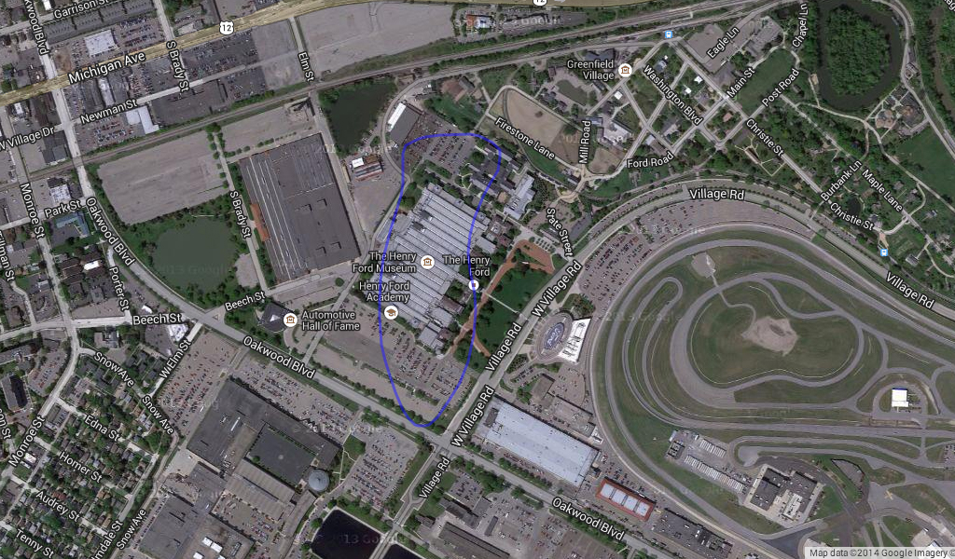
City of David vs. Henry Ford Museum, Dearborn
Notes:
City of David http://mapfrappe.com/?show=19131

Slide 11
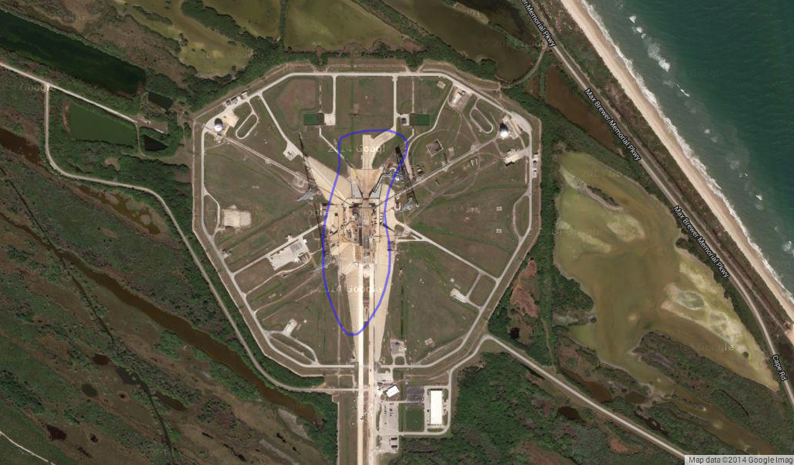
City of David vs. Cape Canaveral launch pad 39B
Notes:
City of David http://mapfrappe.com/?show=19131

Slide 12
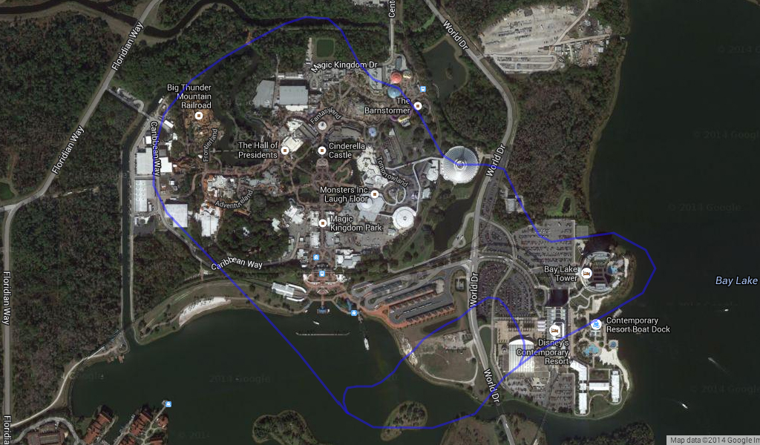
Hazor vs. Disney World Magic Kingdom
Notes:
Hazor http://mapfrappe.com/?show=19137

Slide 13
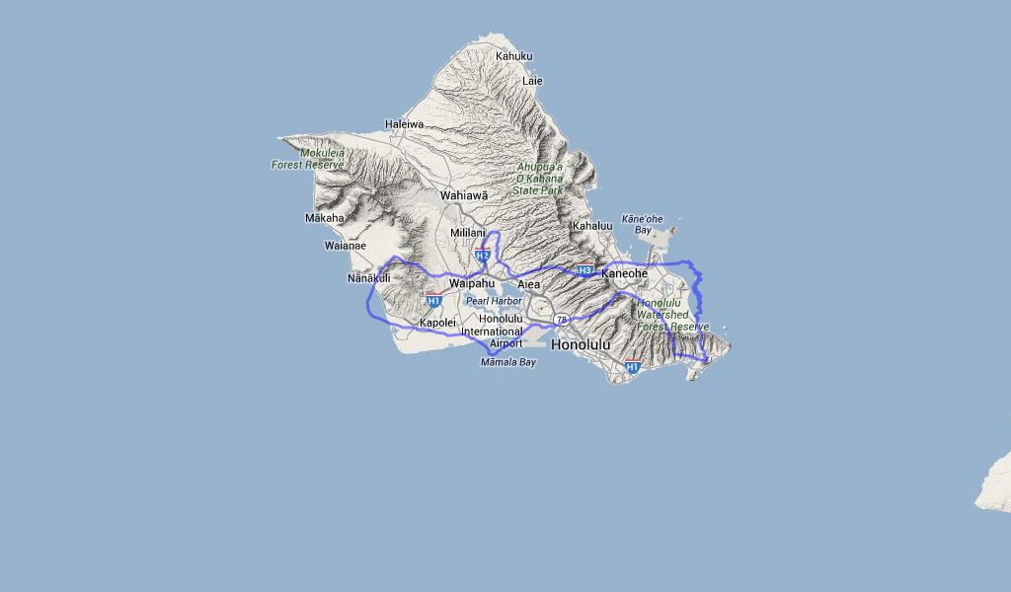
Tribe of Benjamin vs. Oahu, Hawaii
Notes:
Benjamin http://mapfrappe.com/?show=19135

Slide 14
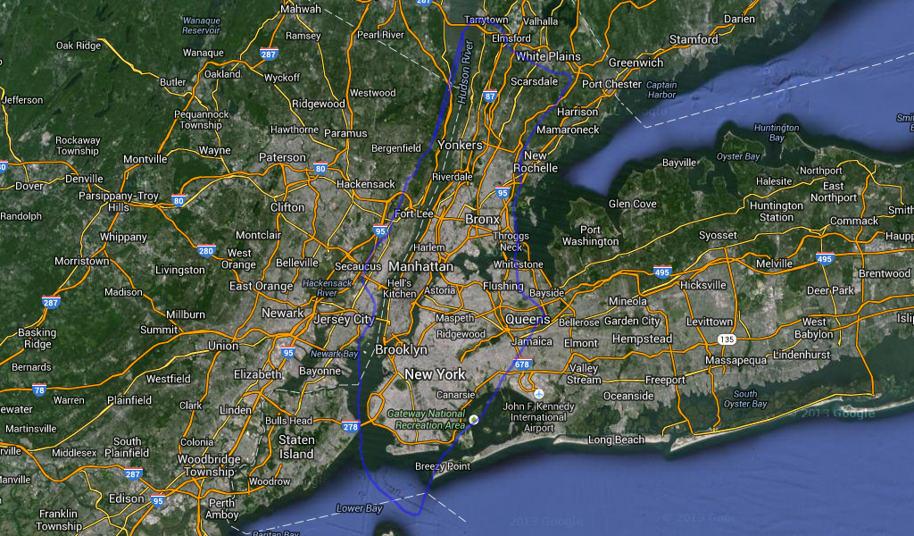
Judean Shephelah vs. New York City
Notes:
Shephelah http://mapfrappe.com/?show=19132

Slide 15
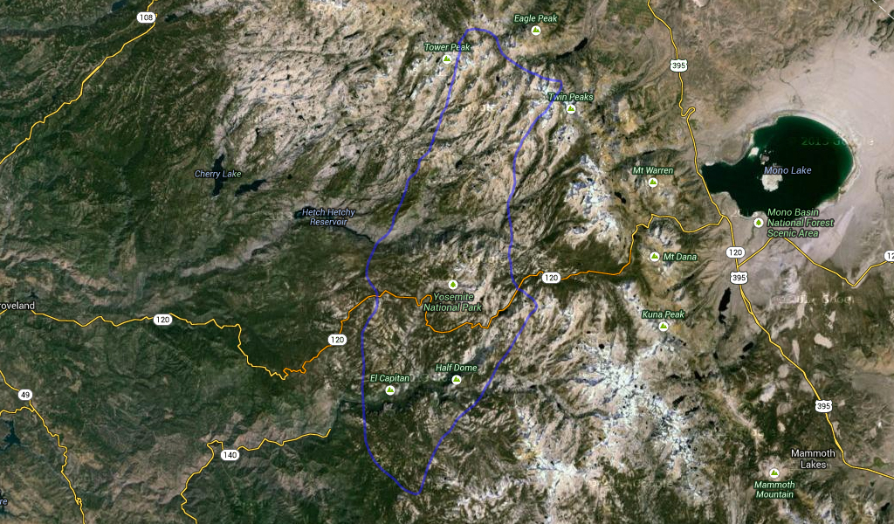
Shephelah vs. Yosemite National Park
Notes:
Shephelah http://mapfrappe.com/?show=19132

Slide 16
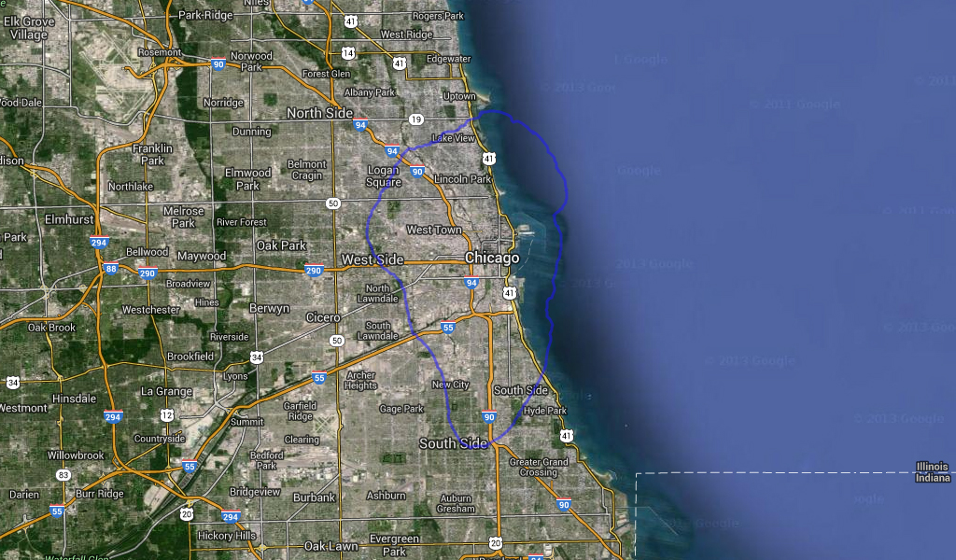
Sea of Galilee vs. Chicago
Notes:
Sea of Galilee http://mapfrappe.com/?show=18968

Slide 17
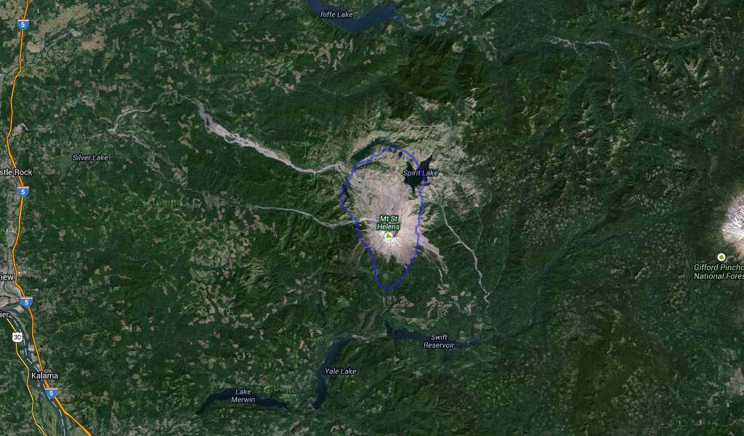
Sea of Galilee vs. Mount St. Helens
Notes:
Sea of Galilee http://mapfrappe.com/?show=18968

Slide 18
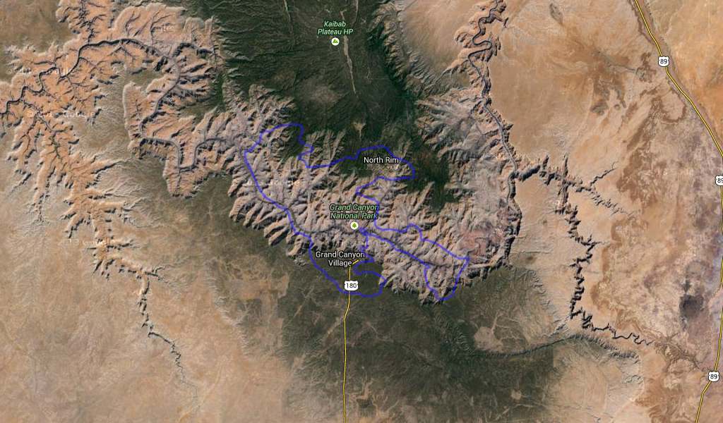
Jezreel Valley vs. Grand Canyon
Notes:
Jezreel Valley http://mapfrappe.com/?show=19136

Slide 19
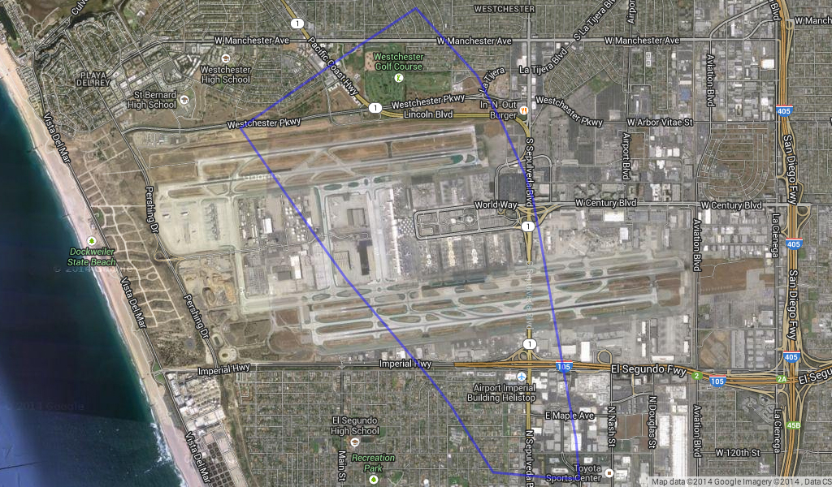
Nineveh vs. Los Angeles International Airport
Notes:
Nineveh http://mapfrappe.com/?show=19153

