Slide 1
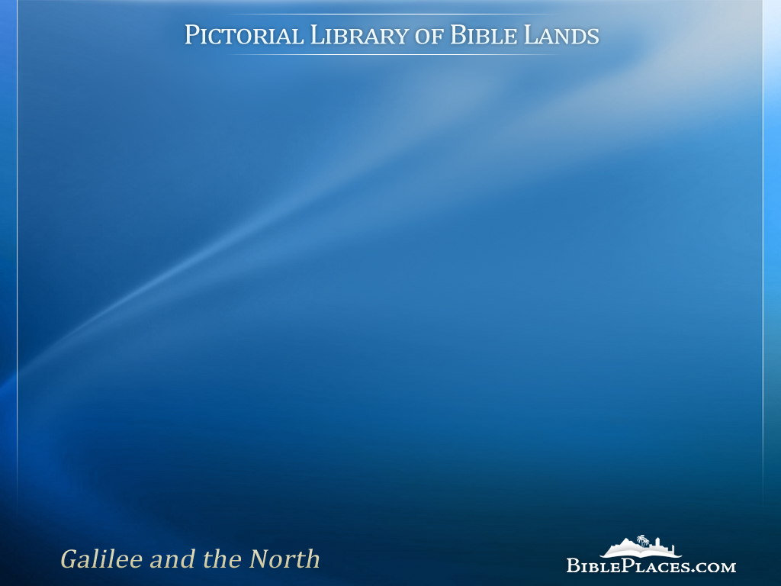
Galilee Sampler
Images from the Pictorial Library of Bible Lands, Revised and Expanded edition, Volume 1
Notes:
This presentation proceeds roughly from north to south, beginning with Mount Hermon and concluding with the Jordan River south of the Sea of Galilee. The images and annotations are a representative sample of the 1,100 images in the Galilee and the North volume of the Pictorial Library of Bible Lands.
This presentation, including its maps and photographs, are copyrighted by Todd Bolen. Permission to use is granted for personal and educational purposes. Commercial use or re-distribution requires written permission.

Slide 2
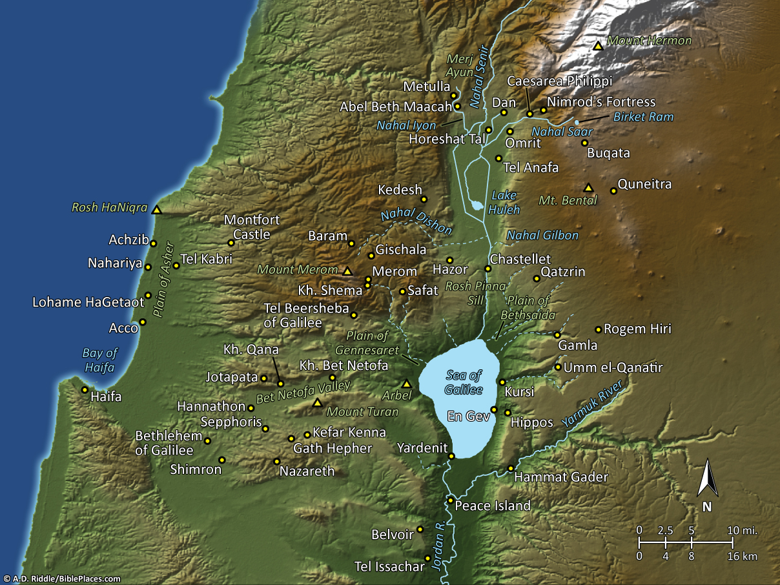
Pictorial Library Vol. 1: Galilee and the North
Notes:
This map is intended to help users locate the places which appear in the photographs in this presentation. The map therefore does not represent or label every geographic feature, and the sites are a mixture of modern and ancient place names.

Slide 3
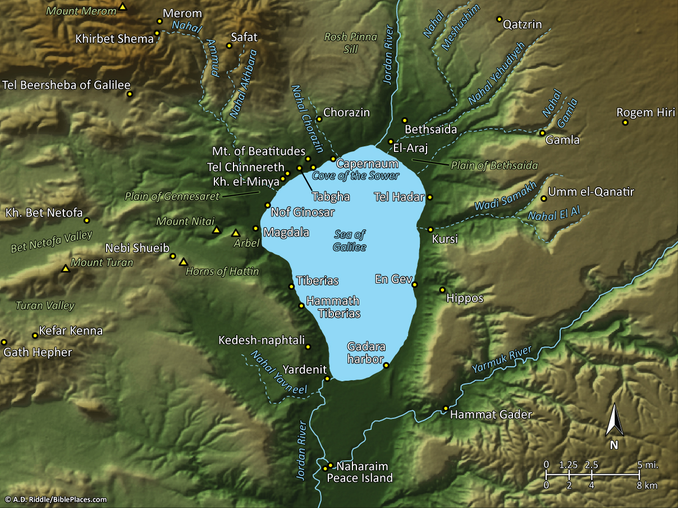
Pictorial Library Vol. 1: Sea of Galilee
Notes:
This map is intended to help users locate the places which appear in the photographs in this presentation. The map therefore does not represent or label every geographic feature, and the sites are a mixture of modern and ancient place names.

Slide 4
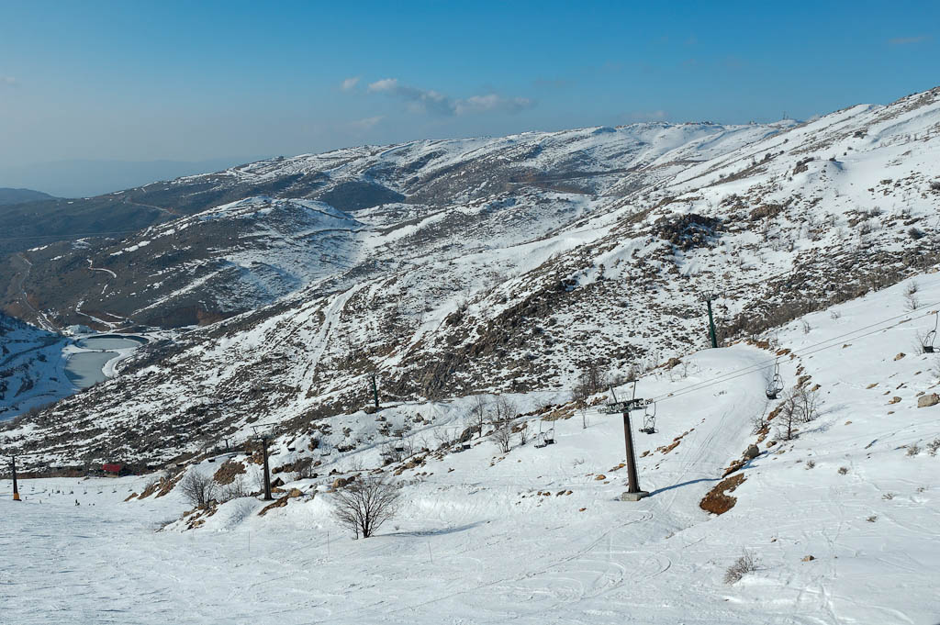
Mount Hermon with snow
Notes:
Mount Hermon
Mount Hermon is the southern extent of the Anti-Lebanon mountain range. Its highest peak is 9,230 feet (2,769 m), and the highest point inside Israel’s borders today is Mizpe Shelagim, the “snow observatory,” at 7,295 feet (2,189 m).
The mountain is the only place with snow skiing in Israel.
Psalm 133 gives an image of the pleasantness and fruitfulness of this mountain. It speaks of the bounty of water, a place that receives much precipitation. Mount Hermon, on average, gets 60 inches (152 cm) of precipitation a year (in 1992 it received 100 inches [250 cm]).
Song of Songs 4:8 (NIV) “Come with me from Lebanon, my bride, come with me from Lebanon. Descend from the crest of Amana, from the top of Senir, the summit of Hermon, from the lions’ dens and the mountain haunts of the leopards.”
Mount Hermon was the northernmost territorial boundary of the land conquered by Joshua (Josh 11:17; 12:1, 4-5). Before the conquest, the Hivites dwelt in this region. It was also the northern border of the half-tribe of Manasseh (1 Chr 5:23)
Psalm 89:12 pictures Hermon as a jewel of the land, almost as if it was singing. “You created the north and the south; Tabor and Hermon sing for joy at your name” (NIV).
The term “Hermon” is not found in any Ancient Near Eastern text.
tb020506136

Slide 5
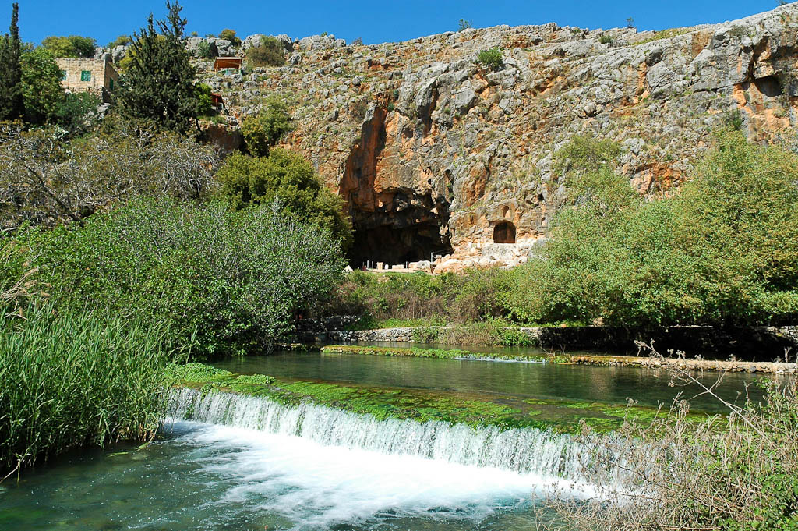
Caesarea Philippi
Notes:
Biblical History of Caesarea Philippi
In the Old Testament the area might have been known as Baal Hermon (Judg 3:3; 1 Chr 5:23), and Baal Gad (Josh 11:17; 12:7). If Baal Hermon was indeed its official name, then it would have been given to Manasseh, as is recorded in 1 Chronicles 5:23.
This site was later was named Panias, after the Greek god, Pan, who was worshiped here.
There is no record of Jesus entering the city, but the great confession and the transfiguration both occurred in the vicinity of the city (Matt 16:13), which was then known as Caesarea Philippi.
tb032905240

Slide 6
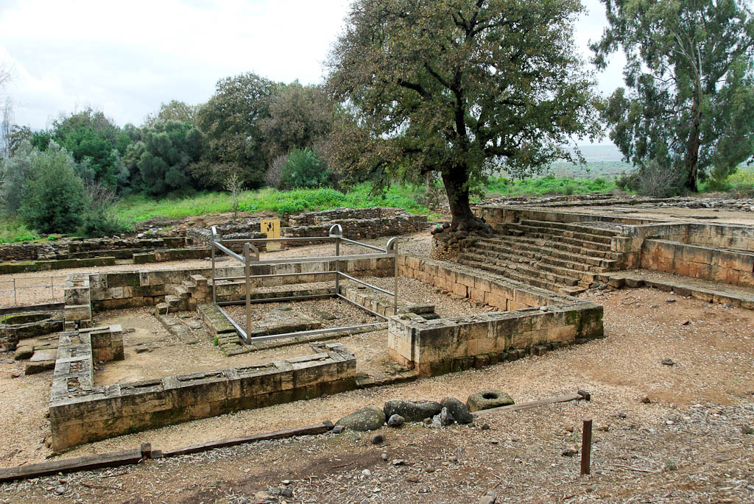
Dan high place of Jeroboam
Notes:
High Place of Jeroboam
The sanctuary erected by Jeroboam was composed of three parts.
The podium. This was used as a temple structure, and steps led up to it. Although A. Biran first thought the podium was an open-air altar, walls were later found on the sides of the structure, which must have supported a roof. Biran now thinks, however, that this was a temple that housed the golden calf, dated to the late 10th century BC.
The main sacrificial altar. This was located in an open area. One horn was found, from which a reconstruction of the whole altar has been made. Steps led up to the altar where the sacrifices took place.
The side chambers. These were used for rituals, minor sacrifices, and administration. Three iron shovels, a small horned altar, an iron incense holder, and a lamp with seven spouts have been found. Examples of these utensils go back to the Middle Bronze Age.
tb011310469

Slide 7
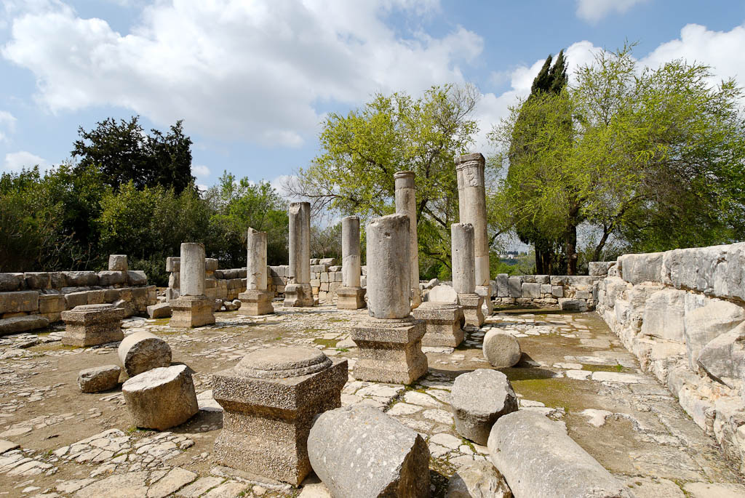
Baram synagogue interior
Notes:
Baram Synagogue
Inside the Baram synagogue, two rows of columns ran the length of the building, and one row ran across the back, thus creating aisles that surrounded the nave on three sides. The city of Baram must have been a flourishing community to have been able to have two synagogues of such quality. The preservation of this particular one is a good model of what Galilean synagogues looked like.
tb032807944

Slide 8
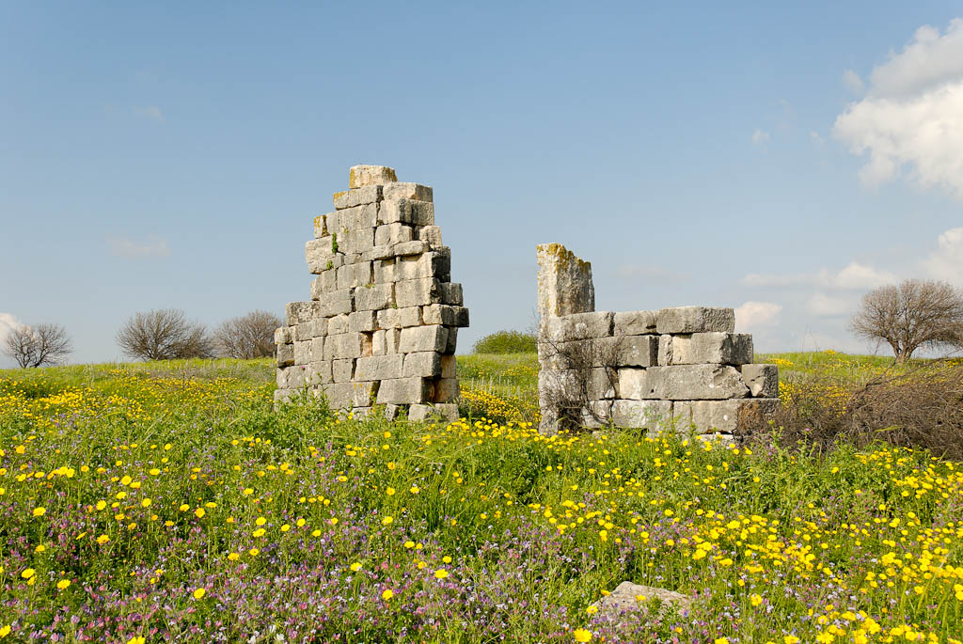
Kedesh Roman temple
Notes:
Evidence from inscriptions and decorations found within the temple indicate that it was dedicated to Baalshamim (“Lord of heaven”), a popular god in this region during the Roman period.
Kedesh of Galilee: History
Kedesh was a Levitical city, as well as a city of refuge allotted to Naphtali (Josh 20:7).
Joshua defeated a king of “Kedesh,” but this may be a reference to the Kedesh of Jezreel (Josh 12:22).
Kedesh was the home of Barak (Judg 4:6) and is the place where Deborah and Barak assembled their followers for the battle with Sisera (Judg 4:1–10).
Tiglath-pileser III captured Kedesh and carried off its inhabitants (2 Kgs 15:29).
tb032807979

Slide 9
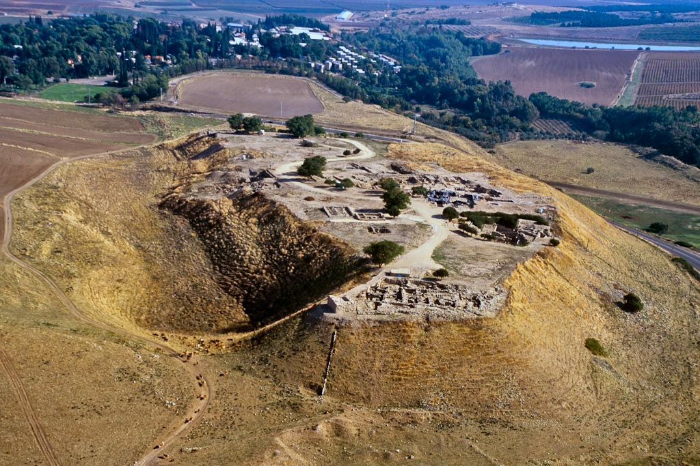
Hazor upper city aerial from west
Notes:
Hazor: Excavations
John Garstang identified this site as Hazor, though he was unaware that it had previously been identified as such by an earlier explorer. He was able to make the identification without the use of Egyptian sources.
Hazor was first excavated by Yigael Yadin and the Hebrew University from 1955 to 1958, and in 1969.
A tourist in the 1960s found a lump of clay with writing on it at Hazor and took it back to the U.S. He later showed the piece to Shalom Paul, who recognized it as a cuneiform tablet with the name “Hazor” written on it. That piece of pottery confirmed that this tell was indeed the mound of biblical Hazor.
Since 1990 excavations have been conducted by Amnon Ben-Tor of Hebrew University.
tbs112040011

Slide 10
lower city
Solomonic
gate
Canaanite
palace
lower city
Israelite
watersystem
tripartite
building
four-room
house
Israelite
tower
Hazor upper city aerial from west
Notes:
tbs112040011

Slide 11
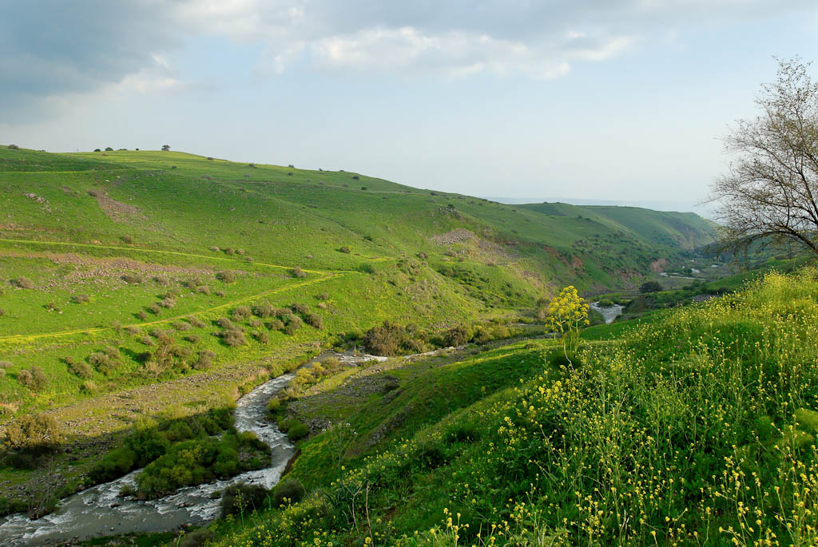
Jordan River north of Sea of Galilee
Notes:
South of the Huleh Basin, the Jordan River flows 7.5 miles (12 km) through a gorge that, in some places, reaches a depth of up to 1,000 feet (300 m).
tb032807034

Slide 12
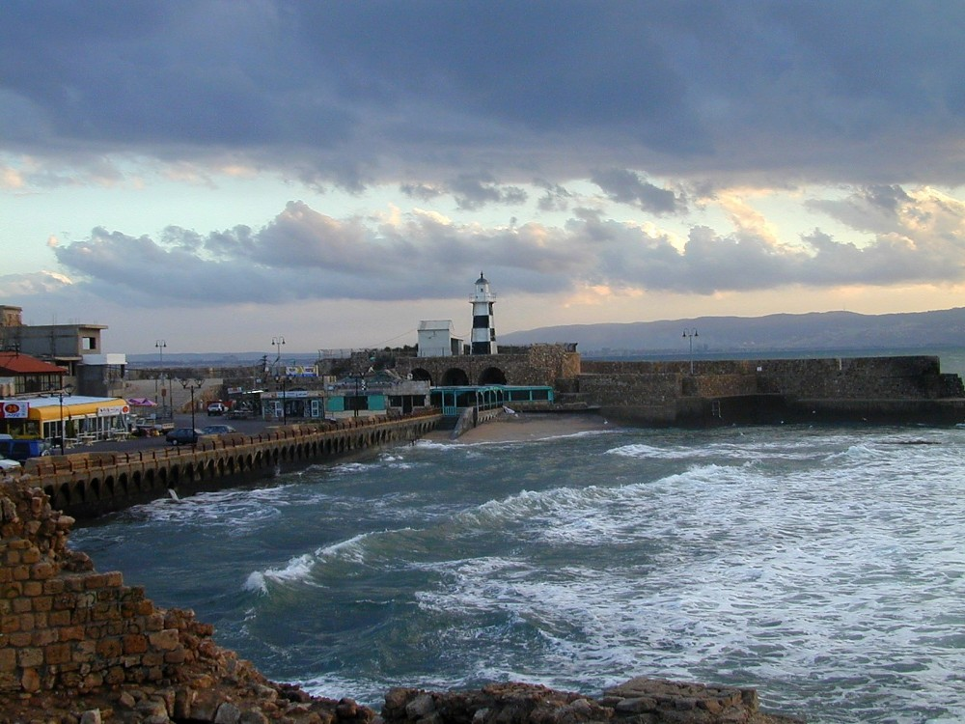
Acco lighthouse
Notes:
Situated on the main sea and land route in ancient times, Ptolemais/Acco served as the main port of the region until Caesarea was built. It was at this site that Herod the Great received Augustus Caesar, since Caesarea had not yet been completed.
tb122100210

Slide 13
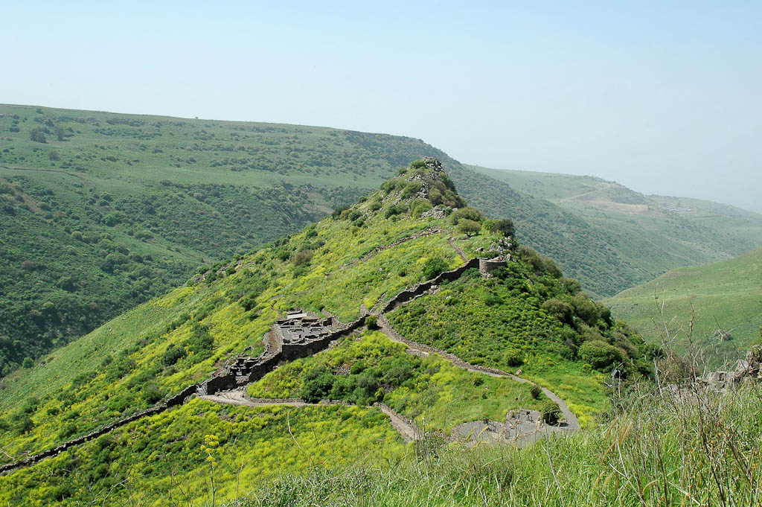
Gamla from east
Notes:
Brief History of Gamla
In Early Bronze I-II (3000-2500 BC), the city was settled and fortified.
Gamla was resettled during the Hellenistic period by exiles returning from Babylon.
Herod the Great settled Jews at Gamla in his effort to populate the borders of his kingdom.
Josephus speaks of the city as being on top of a steep hill surrounded by cliffs and approachable only by a single path. This same path is in use today.
Jewish rebels fortified the eastern part of the city beginning in AD 66.
King Herod Agrippa II attacked the city, but after seven months of unsuccessful siege, he withdrew his forces.
Vespasian, the future emperor of Rome, attacked the city with three legions and some auxiliary forces, and after a month, penetrated the city. The defenders, however, turned that brief victory around and stood their ground, killing many of the attackers. A few days later, a second breakthrough was made and the Romans succeeded in capturing the city. Josephus reports that the Roman victory cost 9,000 Jewish lives.
tb032705332

Slide 14
summit
round tower
synagogue
breach
city wall
Gamla from east
Notes:
tb032705332

Slide 15
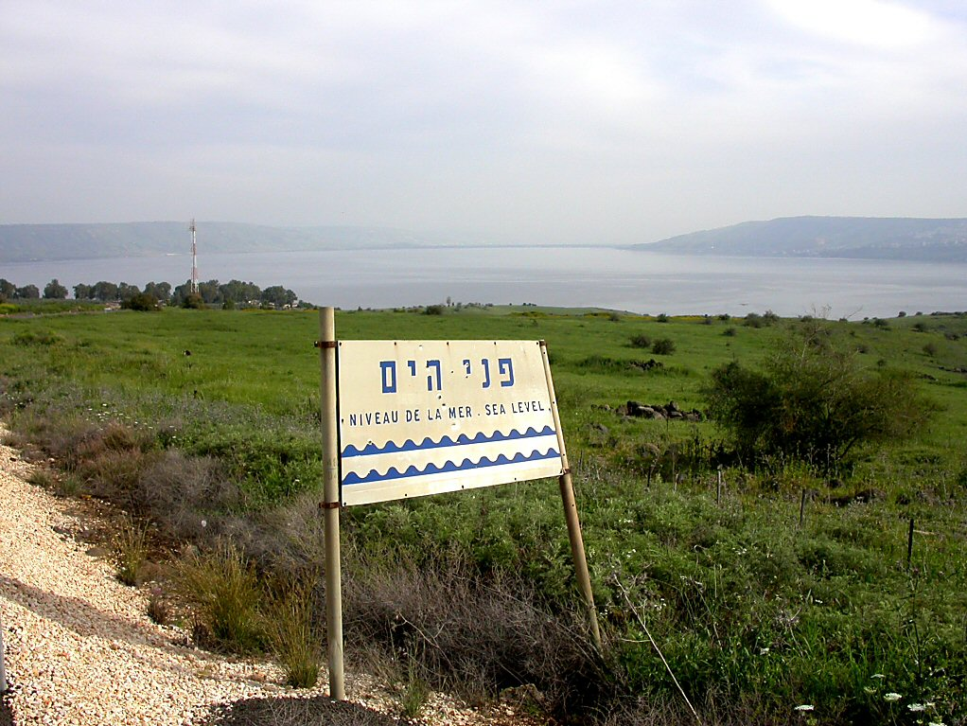
Sea of Galilee sea level sign
Notes:
The Level of the Lake
The water level is higher today than it was in the 1st century AD. This can be observed from the level of the ancient harbors that are mostly under water today.
The Degania dam was built in 1932 and has controlled the level of lake ever since. When it was constructed, the dam caused the lake to rise several meters.
The optimal water level is considered to be 690 feet (208 m) below sea level.
tb041103263

Slide 16
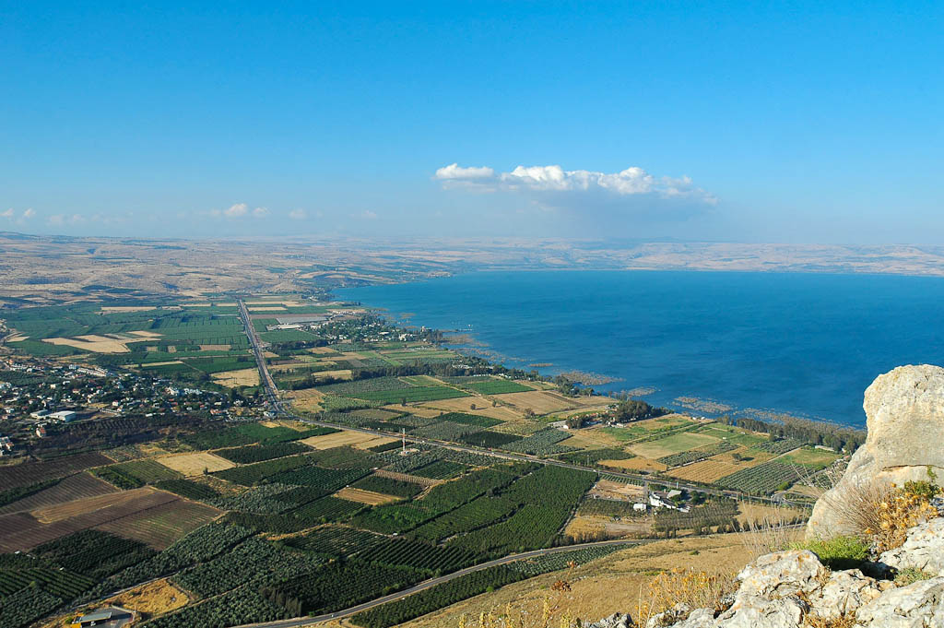
Plain of Gennesaret from southwest
Notes:
tb053005508

Slide 17
Capernaum
Bethsaida
Golan Heights
Mt. of Beatitudes
Plain of Gennesaret
Magdala
Plain of Gennesaret from southwest
Notes:
tb053005508

Slide 18
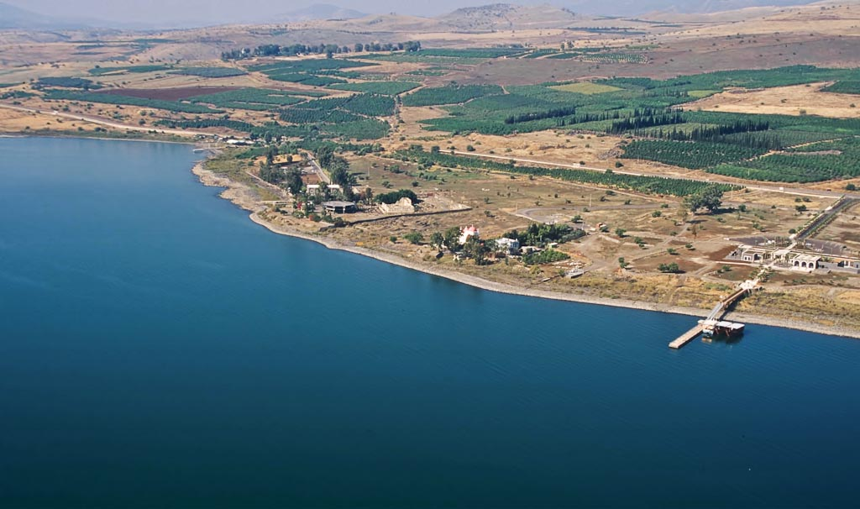
Capernaum area aerial from southeast
Notes:
Capernaum: Introduction
Capernaum’s name comes from the Hebrew Kefar Nahum, meaning “village of Nahum.” The phrase simply became one word in the Greek rendering. It is unknown if the name is a reference to the biblical prophet Nahum, since Capernaum is not mentioned in the Old Testament.
The city is located a little over two miles (3 km) southwest of the spot where the Jordan River enters the Sea of Galilee.
The town began in approximately the 2nd century BC and continued until the Arab invasion in the 7th century AD. It was not utterly destroyed, however, but seems to have slowly grown less and less important. By the time of the Crusades, it was nothing but a small hamlet of only a few fishermen’s houses.
Two important buildings in Capernaum are mentioned by name in some of the early sources: the house of Peter (later converted into a church), and the synagogue (of dressed stones).
Jesus made Capernaum his home during the years of his ministry: “Leaving Nazareth he went and lived in Capernaum” (Matt 4:13, NIV).
Peter, Andrew, James, and John were fishermen living in the village. Matthew, the tax collector, also dwelt in Capernaum.
Capernaum was one of the three cities cursed by Jesus for its lack of faith.
tbs115200011

Slide 19
Church of the Beatitudes
Capernaum synagogue
Greek Orthodox church
Peter’s
house
modern pier
Capernaum area aerial from southeast
Notes:
tbs115200011

Slide 20
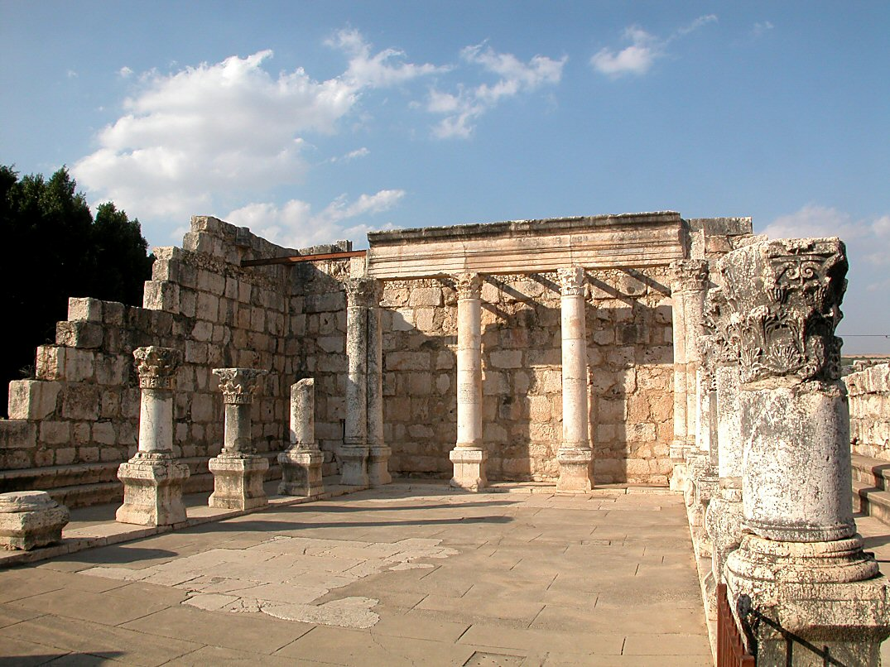
Capernaum synagogue interior
Notes:
Jesus preached the “bread of life” sermon in the synagogue of Capernaum (John 6:16-59). John 6:59 (KJV) “These things said he in the synagogue, as he taught in Capernaum.”
tb102702014

Slide 21
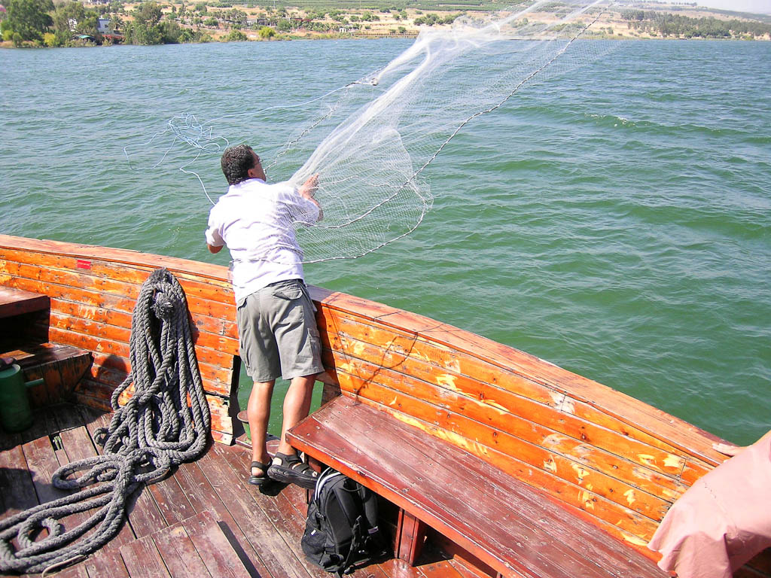
Cast net being thrown
Notes:
The Cast Net
The cast net was a circular net about 18-25 feet (5.5-7.5 m) in diameter. It was thrown by a single fisherman, and lead sinkers that were attached to the edge of the net pulled it down in order to trap the fish. There were two ways to retrieve the net. The fisherman could either dive down into the water and pull the fish out one by one, or the fisherman could gather the edges together and pull the net into the boat or onto the shore. Sometimes a rope was woven around the outside edge of the net, thus allowing the fisherman to retrieve the net by pulling in the rope.
tb052604057

Slide 22
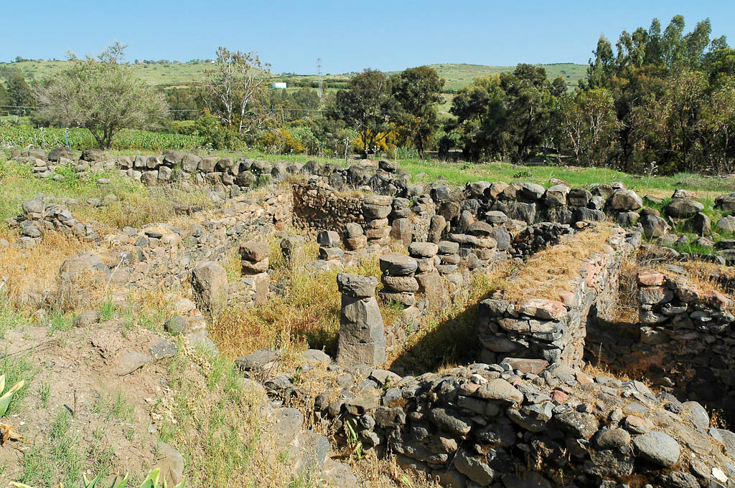
Tel Hadar tripartite pillared building
Notes:
Tripartite pillared buildings are known throughout the land of Israel, including at the sites of Hazor, Megiddo, Beersheba, and En Gev. The excavator, Kochavi, has identified at least 35 of these buildings at 12 different sites (Kochavi 1999: 45). While some believe that this was a standard design for a stable building, others think it was used as a storehouse. Kochavi has proposed that they were ancient shopping malls (1999: 44-50).
The excavators suggest, based upon a similar occupational history, that Tel Hadar was a regional port for Tel Chinnereth on the northwest side of the Sea of Galilee. Grain from Bashan (the Golan Heights) passed through this port on its way to the Mediterranean (Yadin and Kochavi 2008: 1757).
tb032805729

Slide 23
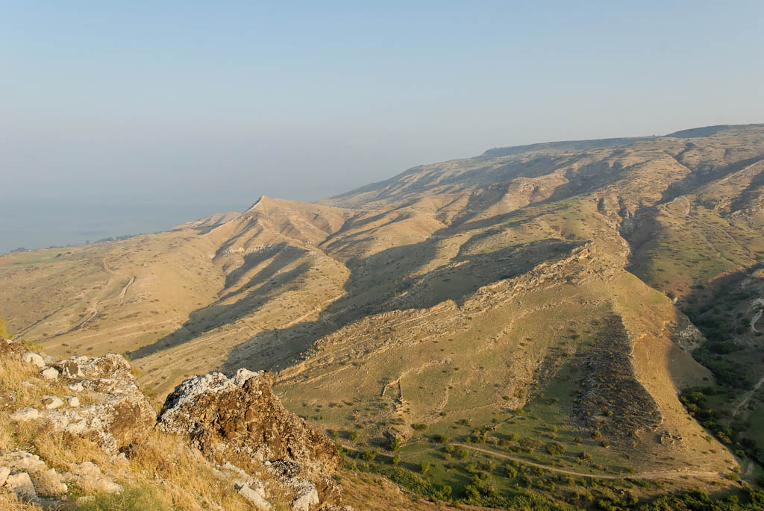
Golan hills north of Hippos
Notes:
Psalm 68:15 (NIV) “The mountains of Bashan are majestic mountains; rugged are the mountains of Bashan.”
tb110406643

Slide 24
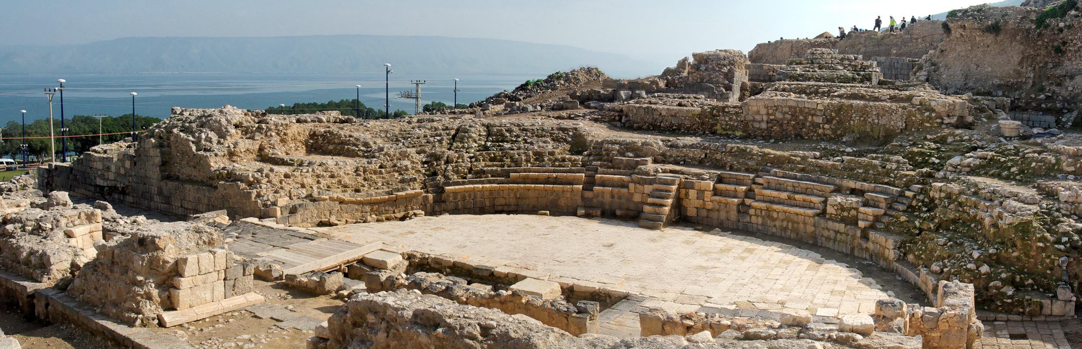
Tiberias theater panorama
Notes:
The theater was constructed at the foot of Mount Berenice, west of the Cardo. Three phases have been revealed:
1: Early Roman (1st century AD)
2: Late Roman (2nd century)
3: Byzantine (4th century)
tb01141053p

Slide 25
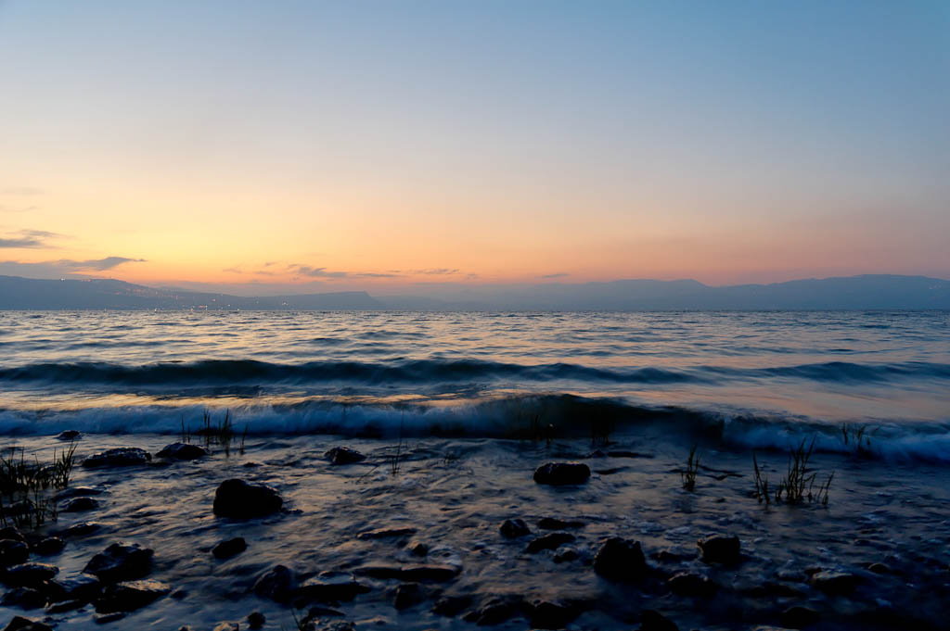
Sea of Galilee at dusk
Notes:
tb040306012

Slide 26
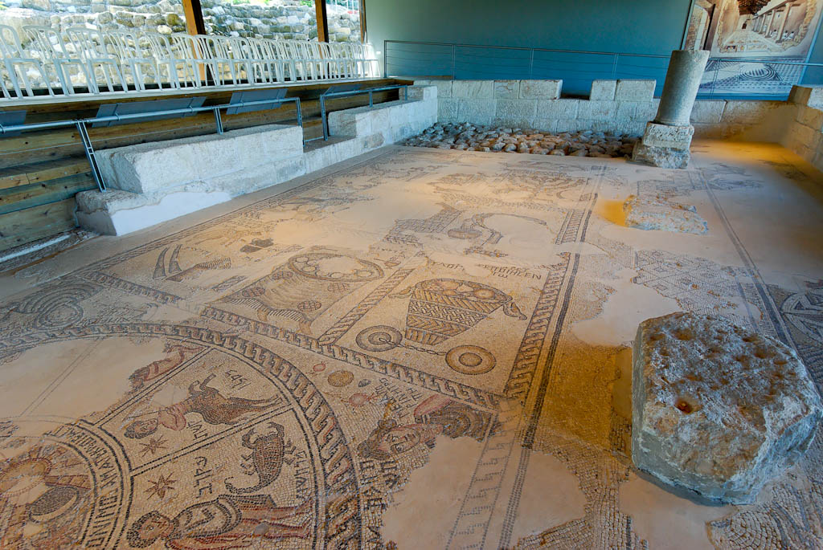
Sepphoris ancient synagogue mosaic
Notes:
Sepphoris in the Rabbinic Period
“The Sanhedrin wandered to ten places of banishment… from Jerusalem to Jabneh, and from Jabneh to Usha…and from Usha to Shefar’am, and from Shefar’am to Beth She’arim, and from Beth She’arim to Sepphoris, and from Sepphoris to Tiberias…” (b. Rosh Hashana 31 a, b).
When Jewish autonomy was restored to Sepphoris in the 3rd century, Rabbi Judah the Prince and the Sanhedrin moved to the city. Rabbi Judah lived in Sepphoris for 17 years until his death (200-217), and it was in this city that he compiled the Mishnah.
Judah the Prince lived and died at Sepphoris. The Talmud, however, says that a burial place was prepared for him at Beth Shearim, and for this reason, Jews wanted to be buried there. A mausoleum located northwest of the hill of Sepphoris, however, is traditionally known as the tomb of Rabbi Judah the Prince.
According to the Talmud, Sepphoris had 18 synagogues, but not one complete synagogue has yet been found at the site. During the Mishnaic and Talmudic periods, many sages dwelt in the city, and the Sanhedrin remained at this location until it moved to Tiberias, under the leadership of Rabbi Yohanan the Amorai, in the middle of the 3rd century AD.
Because of its mixed population, Sepphoris could not be called distinctly Jewish or Gentile in AD 200. Despite being a pagan Roman city, Judah the Patriarch came and lived here.
A Jewish convert to Christianity, Josephus the Apostate, tried unsuccessfully to build a church in Sepphoris during the reign of Constantine.
According to a letter sent by Cyril, the bishop of Jerusalem, the earthquake of 363 is reported to be the cause of Sepphoris’ destruction. The city was rebuilt, and the Christian population then increased during the Byzantine period. The Jewish majority remained, however, until urban life began to dwindle in the Early Arab period.
tb032507654

Slide 27
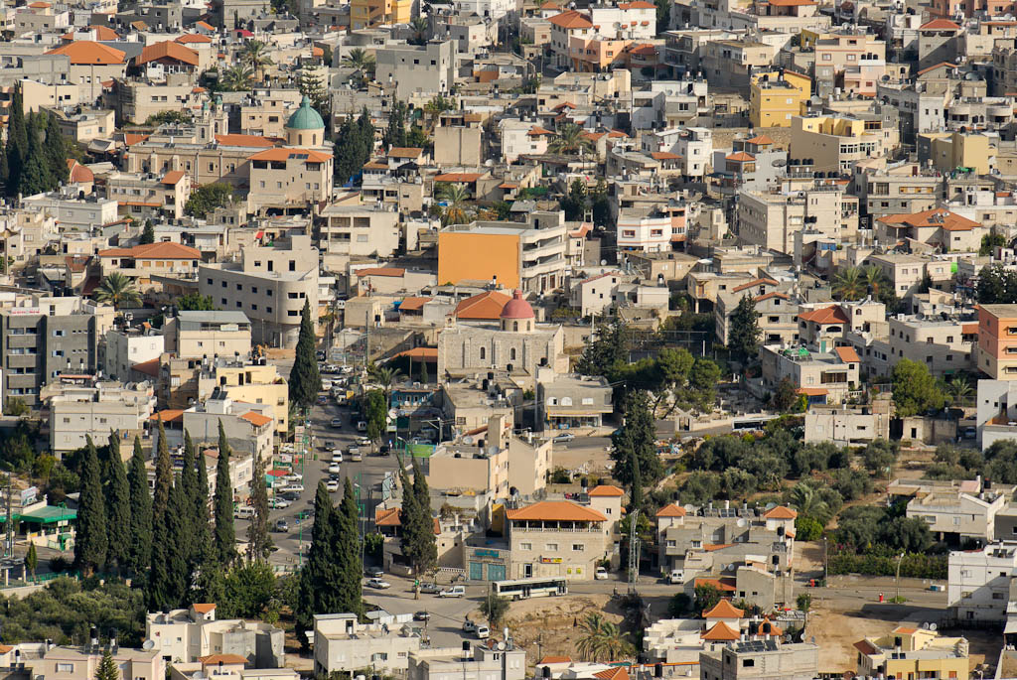
Kefar Kenna from south
Notes:
Kefar Kenna lays claim to being the biblical city of Cana, but this identification is dubious. The name “kenna” is not related to “qana,” and thus the village does not preserve the biblical name. Pilgrims from the Byzantine period seem to have identified Cana at Kefar Kenna, and some suggest this identification was made in part because of the convenient location of the site on the route from Nazareth to Tiberias. Kefar Kenna is located 4 miles (6.4 km) northeast of Nazareth, opposite Gath-Hepher.
tb110106364

Slide 28
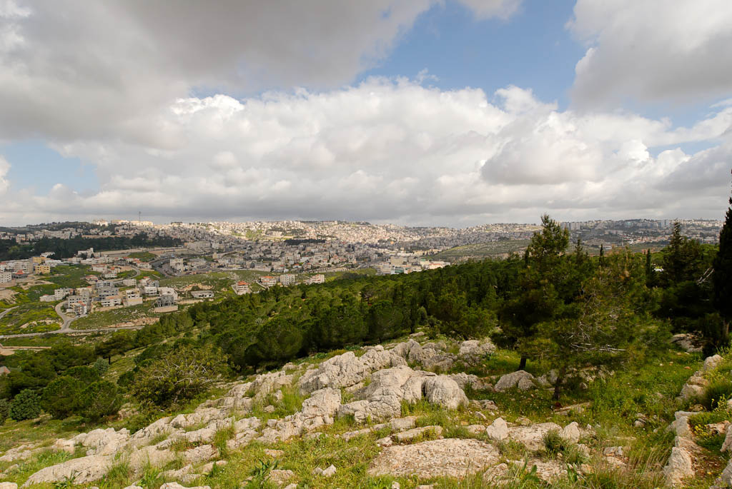
Nazareth from south
Notes:
Archaeology
Archaeological evidence suggests that not more than 200 people resided in Nazareth during the first century AD.
The town itself was small, and tombs have been found along the outskirts of the city indicating the limits of the inhabited areas.
Extant remains at Nazareth from the 1st century AD consist mainly of cisterns, silos and tombs cut from rock.
tb032507547

Slide 29
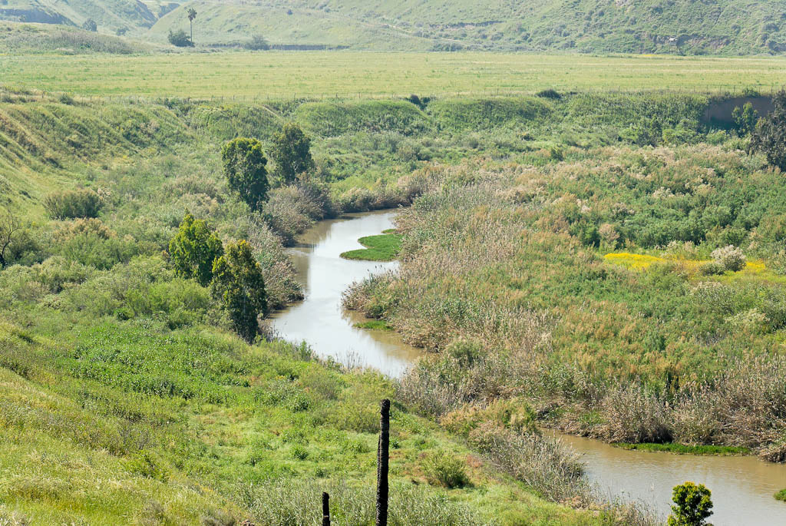
Jordan River near Peace Island
Notes:
The river winds so much on its journey from the Sea of Galilee to the Dead Sea that the entire course runs about 130 miles (208 km), instead of the 60 miles (96 km) it would take if it ran a straight course.
tb033007185

Slide 30
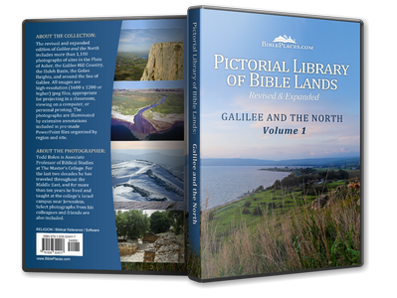
This sampler is taken from the Pictorial Library of Bible Lands, Revised and Expanded edition, Volume 1: Galilee and the North.
Galilee and the North includes more than 1,100 photos like these – all in high-resolution.
Each photo is clearly labeled. Most slides have descriptive explanations (see notes section below).
Designed for ease of use. PowerPoint presentations, jpg files, no watermarks, few restrictions.
If you don’t love it, return it!
Free shipping within U.S.
For more information about this volume, go to: http://www.bibleplaces.com/01-galilee-and-the-north-revised.htm

Slide 31
This sampler is taken from the Pictorial Library of Bible Lands, Revised and Expanded edition, Volume 1: Galilee and the North. Other presentations on this volume include:
Bethsaida
Capernaum
Chorazin
Dan
Galilee Hill Country
Gamla
Golan Heights
Hazor
Hippos
Huleh Basin
Jordan Rift
Jordan River North
Kedesh
Mount Hermon
Nazareth
Plain of Asher
Sea of Galilee-East Side
Sea of Galilee-Fishing
Sea of Galilee-Scenes and Sunsets
Sea of Galilee-West Side
Sepphoris
Tabgha
Tiberias
For more information about this volume, go to: http://www.bibleplaces.com/01-galilee-and-the-north-revised.htm

Slide 32
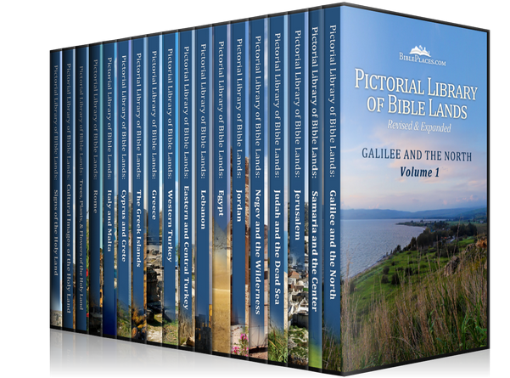
Galilee and the North is volume 1 of the Pictorial Library of Bible Lands, a collection of 17,600 high-resolution images of biblical sites and scenes. Other volumes in the collection include:
Samaria and the Center
Jerusalem
Judah and the Dead Sea
Negev and the Wilderness
Jordan
Egypt
Lebanon
Eastern and Central Turkey
Western Turkey
Greece
The Greek Islands
Cyprus and Crete
Italy and Malta
Rome
Trees, Plants, and Flowers
of the Holy Land
Cultural Images
of the Holy Land
Signs of the Holy Land
For more information about the Pictorial Library of Bible Lands, go to: http://www.bibleplaces.com/details.htm

